Slide 1
Imaging Processing

Slide 2
What is Image Process?
The Image Processing is an electronic form of document filing.
A paper document is passed through a scanner to make a digitized image, then stored on a storage device
It is the process of scan, Crop, Edit, Enhancement and Indexing then stored on a storage device

Slide 3
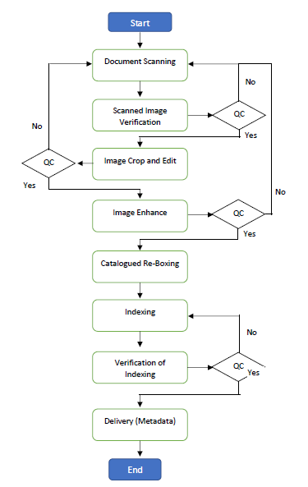
Workflow Process

Slide 4
Key Process
Imaging Process
Scanning
Crop
Edit
Basic Index
Image Enhancement
Full Index

Slide 5
Scanning Items
Scanning from Paper document
Scanning from book
Scanning from microfilm
Scanning from other classic devices

Slide 6
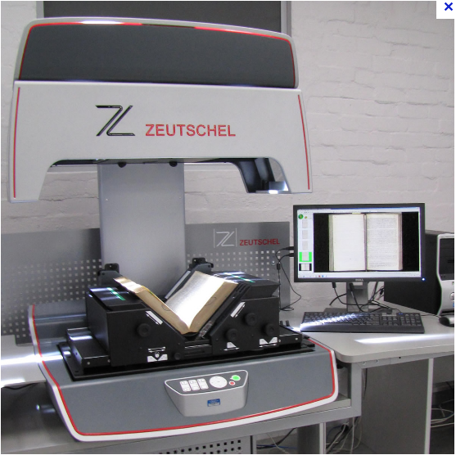
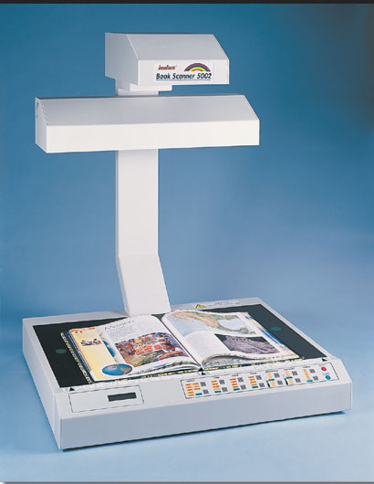
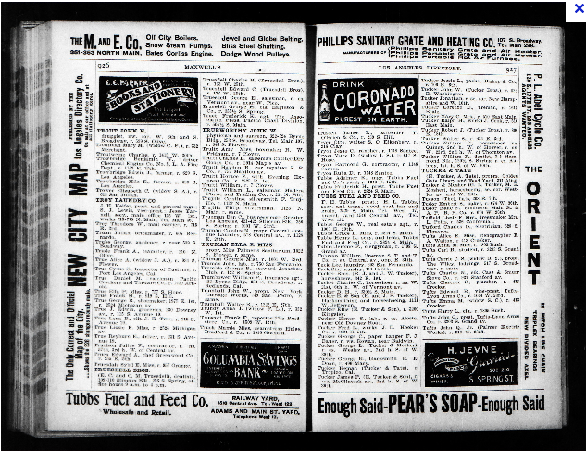
Book Scanning

Slide 7
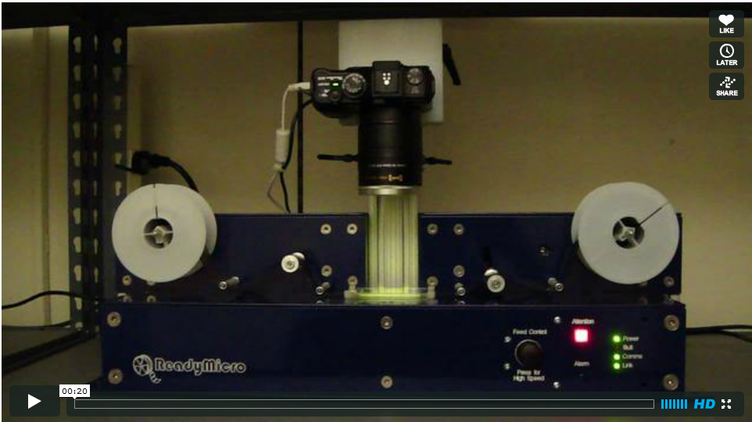
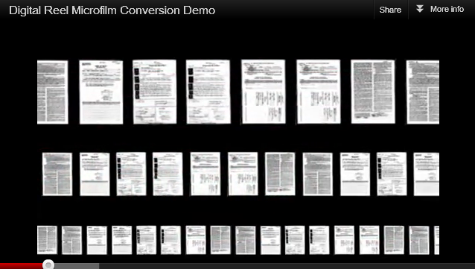
Microfilm roll scanning

Slide 8
What is mean by cropping?
Cropping refers to the removal of the outer parts of an image to improve framing, transformation of images and other common scanning defects and corrections It’s a process to re arrange the length and breath of an image

Slide 9
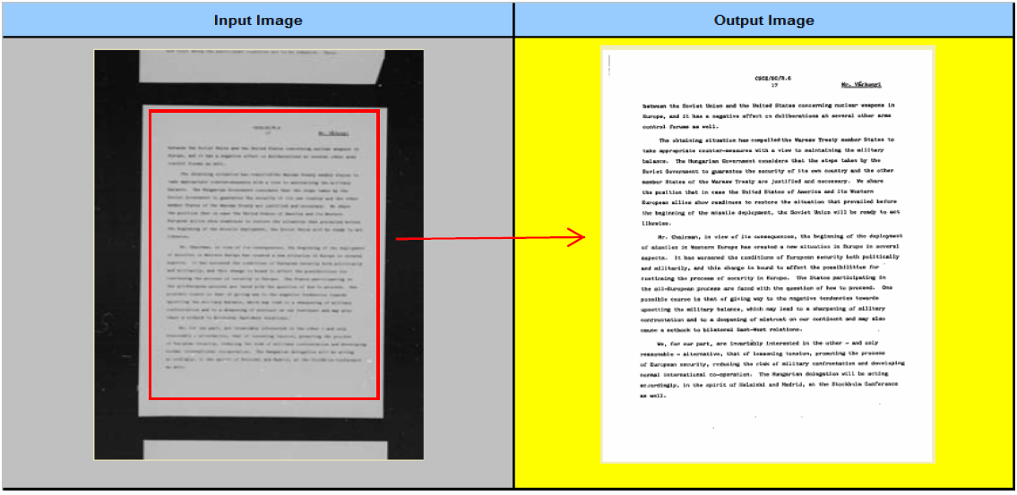

Slide 10
What does mean by Image Edit
Image editing enclose the processes of altering images such as removal of black border, removal of unwanted vertical and horizontal lines in between the text, removal of unwanted blank pages, identify missing pages and etc, Image editing is known as re-arranging of scanned pages

Slide 11
Key note of Edit
When Editing be sure all information is legible.
Stamp Dates and Times
Seals
Names
Addresses
Legal Descriptions
Signatures.

Slide 12
Instructions of crop and edit
Negative Transform
Mirror Horizontal / Vertical
Deskew
Rotate 180, Rotate 90 Right and Rotate 90 Left
Black Border Removal
Darken / Lighten Image
Delete pages
Page number arranged
Masking
Split Images

Slide 13
Negative Transform
Transform a negative image to positive A positive image is a normal image A negative image is a total inversion of a positive image, in which light areas appear dark and vice versa We needs to edit the image that transform the image from negative to positive image with help of application
Shortcut key=“N”

Slide 14
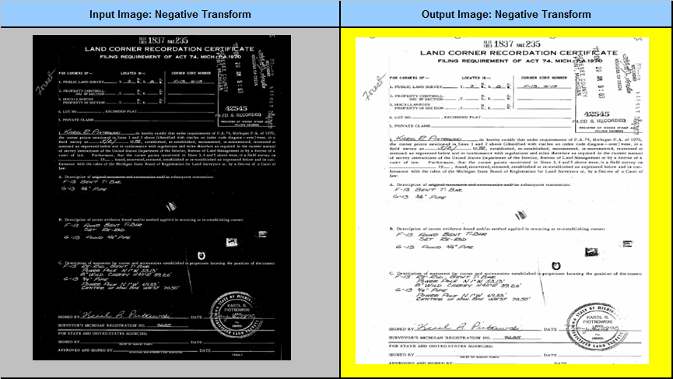

Slide 15
Mirror Horizontal and Mirror Vertical
Straighten mirror images A mirror image is a reflected duplication of an object that appears identical but reversed in horizontal We needs to fix the problem and edit such images and bring it to normal view
Shortcut key= H & V

Slide 16
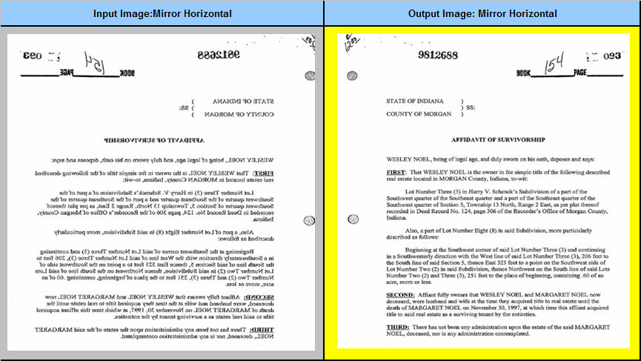

Slide 17
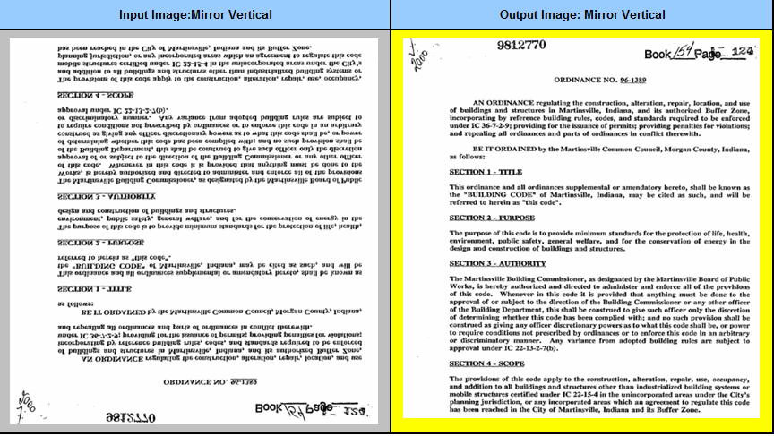

Slide 18
Deskew
Straighten crooked images, due to high-volume scanners, automatic document feeder inevitably skew paper We needs to fix the problem and obtain straighten images without rescan
Shortcut Key=“D”

Slide 19
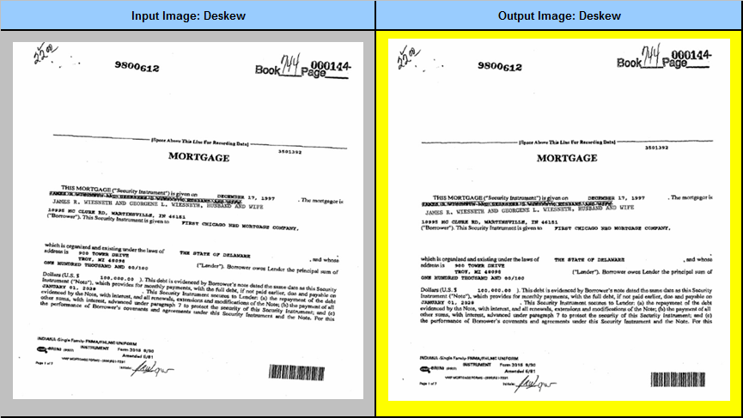

Slide 20
Rotate 180, Rotate 90 Right and Rotate 90 Left
Rotate images, due to high-volume scanners, automatic document feeder inevitably skew paper

Slide 21
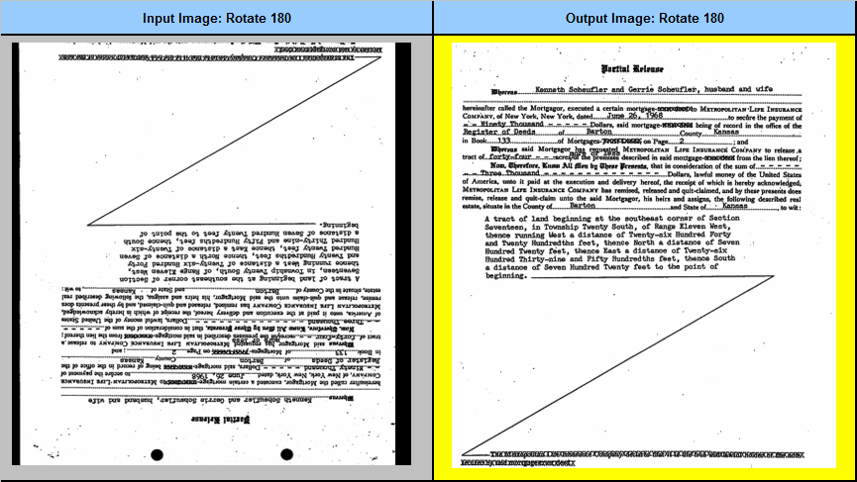

Slide 22
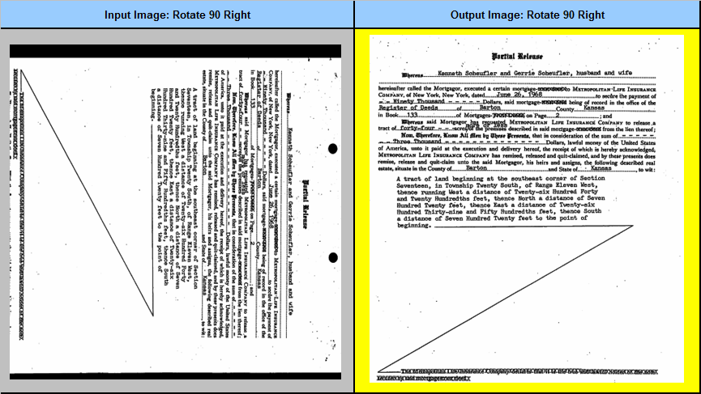

Slide 23
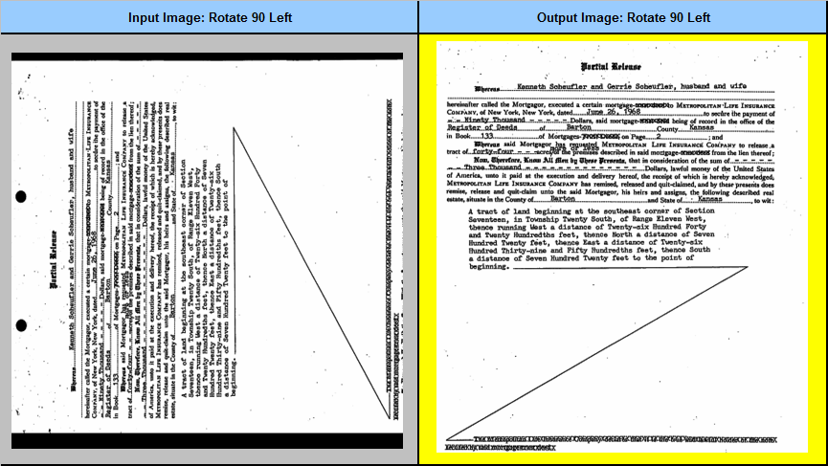

Slide 24
Black Border Removal
Remove black border around images, the black border will be produced due to paper scanner with black background We needs to fix this problem and remove the black border around the images

Slide 25
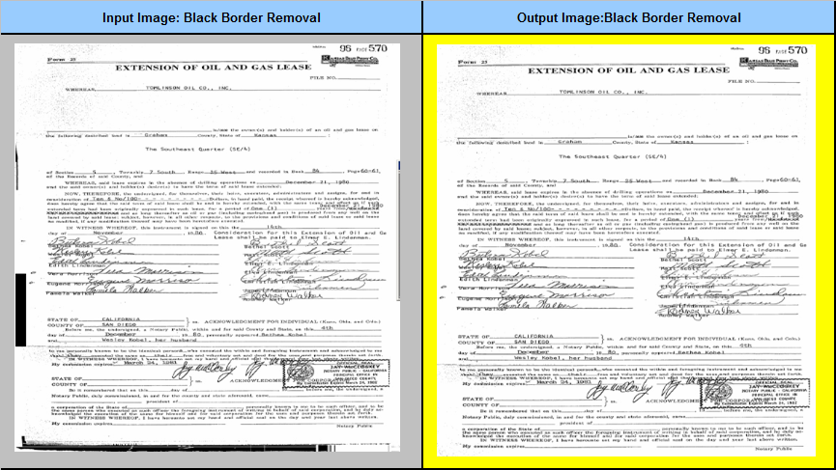

Slide 26
Darken / Lighten Image
Balance the light and Darkness of an Image If an image has very less or high contrast and brightness, We needs to adjust the contrast and brightness while doing crop and edit
+ or - symbol

Slide 27
Delete pages
Delete Pages Delete unwanted pages, and exact duplicate pages

Slide 28
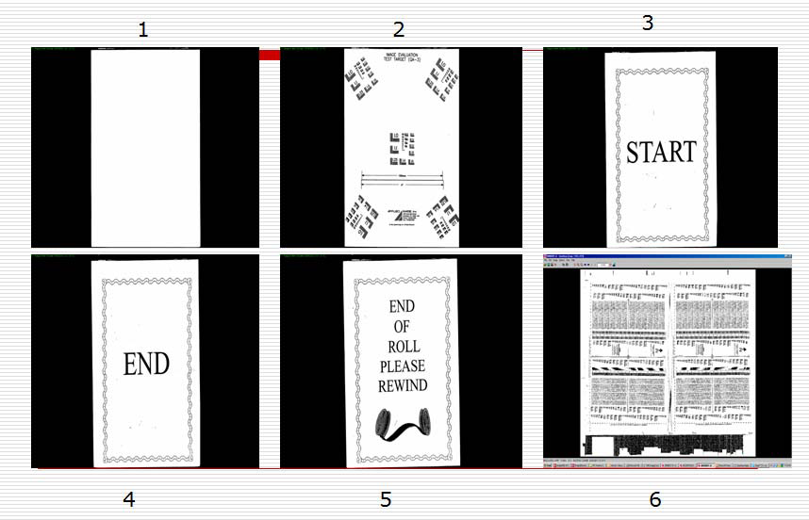

Slide 29
Masking
Remove grayscale and cleaning images Some of scanning paper copies has grayscale shading We needs to fix the problem and clean the grayscale shading

Slide 30
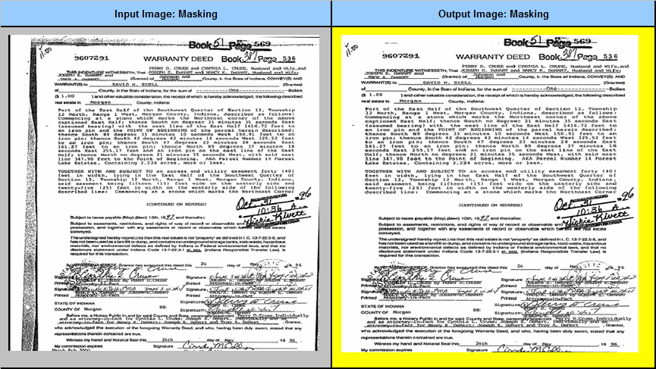

Slide 31
Page number arranged
Page number rearranged It there is reversal page numbers or the page number with non sequential order, We needs to rearrange the images as per the pagination

Slide 32
Split Images
If there is an image with multiple pages, the image needs to be split based on the multiple pages while doing crop

Slide 33
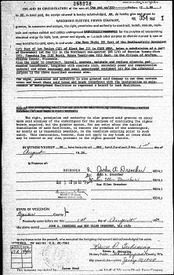
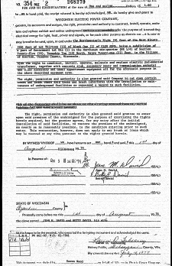
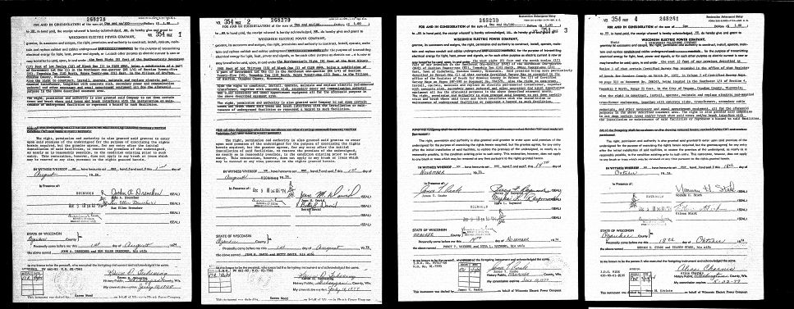

Slide 34
Image Retakes
Please make sure that when editing all information is legible on Stamp Dates and Times, Seals, Names, Addresses, Legal Descriptions, Signatures and other non editable scanning errors in the image, else it should be flagged as “Retake” with suitable below listed reasons

Slide 35
Instructions of Image Retakes
Darken Image
Lighten Image
Out of Focus
Bleed Through
Microfilm Retake
Polarity
Notation
Vertical or Horizontal Line Removal
Cut Off
Missing Page
Other Scanner Error

Slide 36
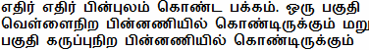
Polarity
This is a problem where some images have half part of the page with white background and part of the page with black background. We needs to reconvert such images with different backgrounds.

Slide 37
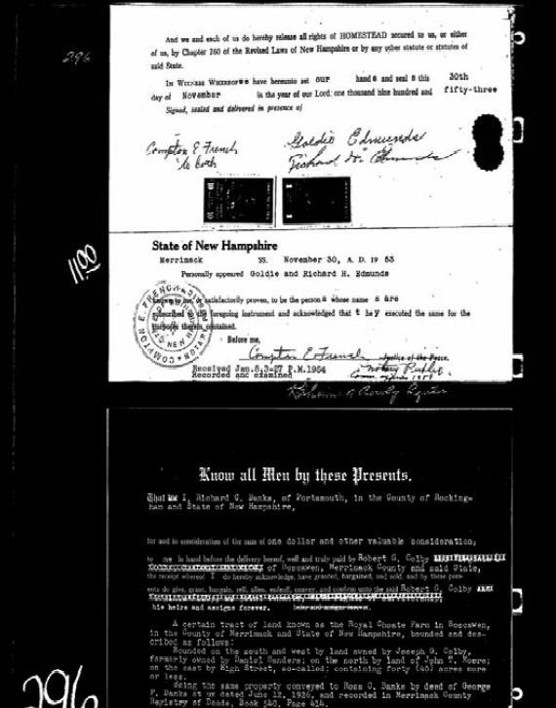
Polarity Retake

Slide 38
Notation
A note is typed or written in the margin that surrounds the page (also called as marginalia notation). We will mark such images as “Retake” for reconverting the image.

Slide 39
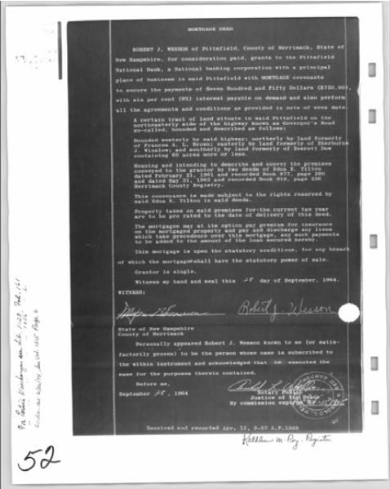
Notation Retake

Slide 40
Vertical or Horizontal Line Removal
Remove lines, horizontal, vertical or both. The line removal is so smart that lines crossed in between the text characters. We needs to flag it as “Retake” for reconverting the page.

Slide 41
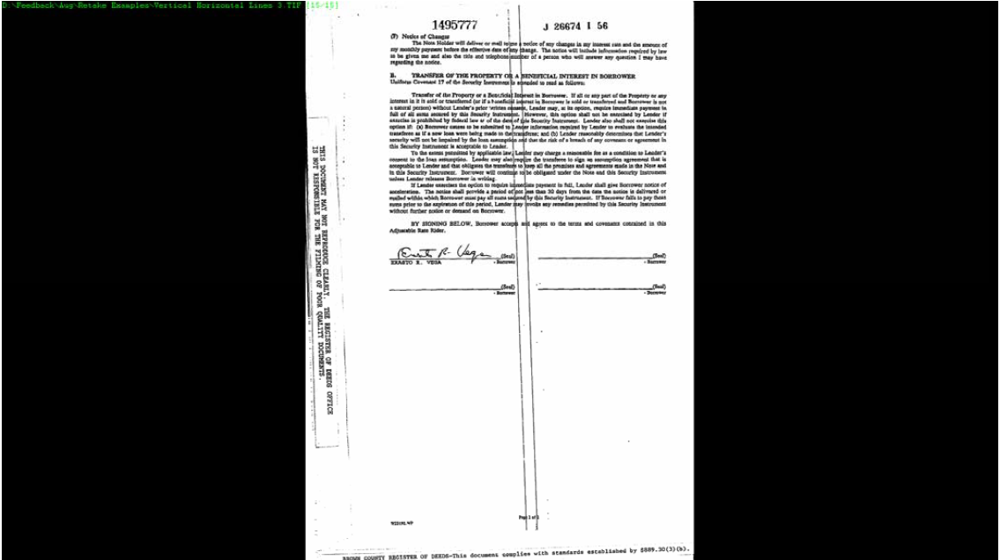
Vertical or Horizontal Line Removal Retake

Slide 42
Cut Off
A portion of the page appears to be Cut Off or missing. We needs to flag such images as "Retake" for re-converting.

Slide 43
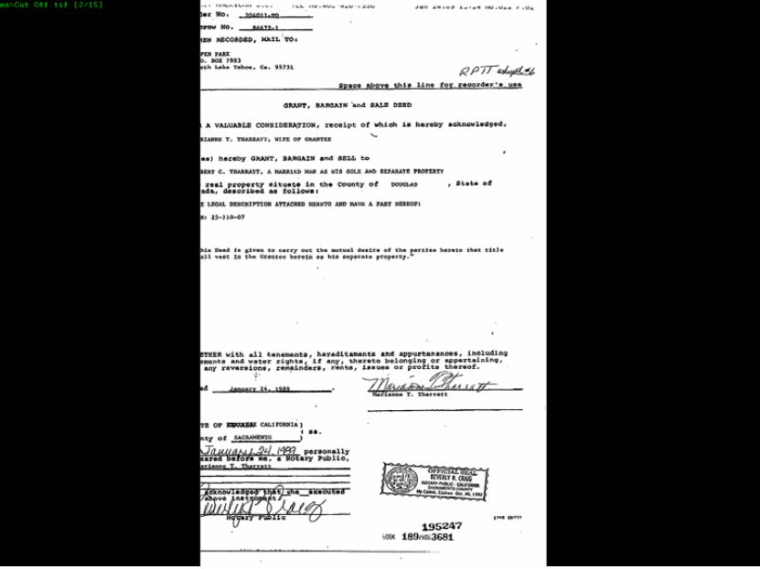
Cut Off Retake

Slide 44
Missing Page
If a sequentially numbered image is completely missing, we needs to flag it as “Retake” for finding the image in the original scanned image
page 1, page2, page3, Page5,

Slide 45
Bleed Through
Reversed text is bleeding through the page. If data and text present on back side of the Image are visible on front side of the image due to transparency. We needs to fix the problem and flag this type of Images as retake for reconverting the image

Slide 46
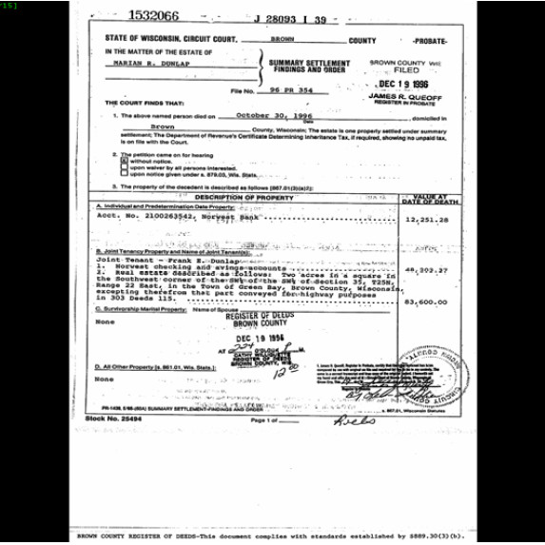

Slide 47
Out of Focus /Poor Image
Image is blurry and hard to read. If there is out of focus image where as information is not legible on Stamp Dates and Times, Seals, Names, Addresses, Legal Descriptions and Signatures, We will flag it as “Retake” for reconverting the image.

Slide 48
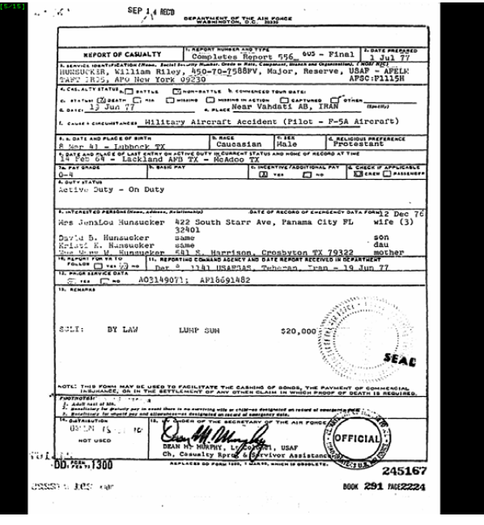

Slide 49
Darken and Light Image &
Image is dark all over or any specific area. If there is an illegible darken image which we are unable to adjust contrast and brightness while editing, We will flag this Image as “Retake” for reconverting the image
Image is light all over or any specific area. If there is an illegible light image which we are unable to adjust contrast and brightness while editing, We will flag this Image as “Retake” for reconverting the image

Slide 50
Image Enhance
Image enhancement is the process of adjusting digital images so that the results are more suitable for display or further image analysis. For example, you can remove noise, sharpen, or brighten an image, making it easier to identify seal or signatures.
Enhancing grayscale images with histogram equalization.
Contrast-limited adaptive histogram equalization

Slide 51
Indexing
Indexing is the process of describing or classifying a document by index terms or other symbols in order to indicate what the document is about, to summarize its content or to increase its findability. In other words, it is about identifying and describing the subject of documents.
General Indexing fields are
Book number
Page number
Document number
Document Date
Granter
Grantee
Document type

